Slide 1
Microservice
Implementing Microservice using Docker
By Adi Setyono (adi.setyono@gmail.com)

Slide 2
Microservice Architecture
Storefront UI
Catalog
Service
Catalog Database
REST
HTML
API Gateway
Browser
REST
Reviews
Service
Reviews
Database
Order
Service
Order
Database
REST
Mobile Device
…
Service
…
Database
Notes:
What we saw previously as a single stack application now become standalone, composable services

Slide 3
Benefits of Microservices
Can scale independent microservices separately. No need to scale the whole the system
Can use the latest technologies to develop the microservices.
One component failure will not cause entire system downtimes.
When developing an overall solution we can parallel the microservices development task with the small teams. So it helps to decrease the development time.

Slide 4
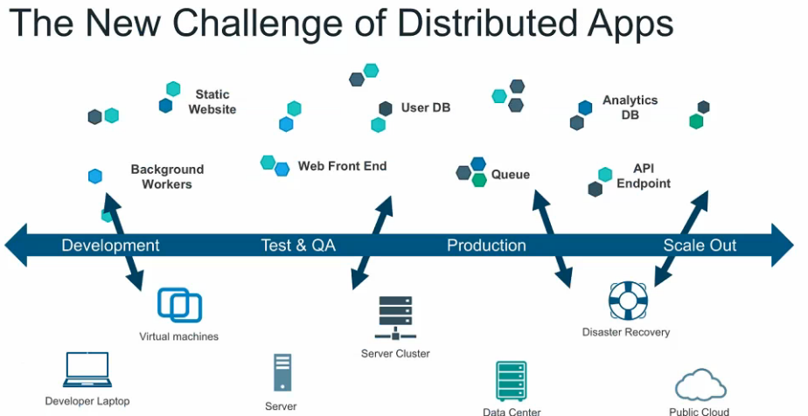

Slide 5
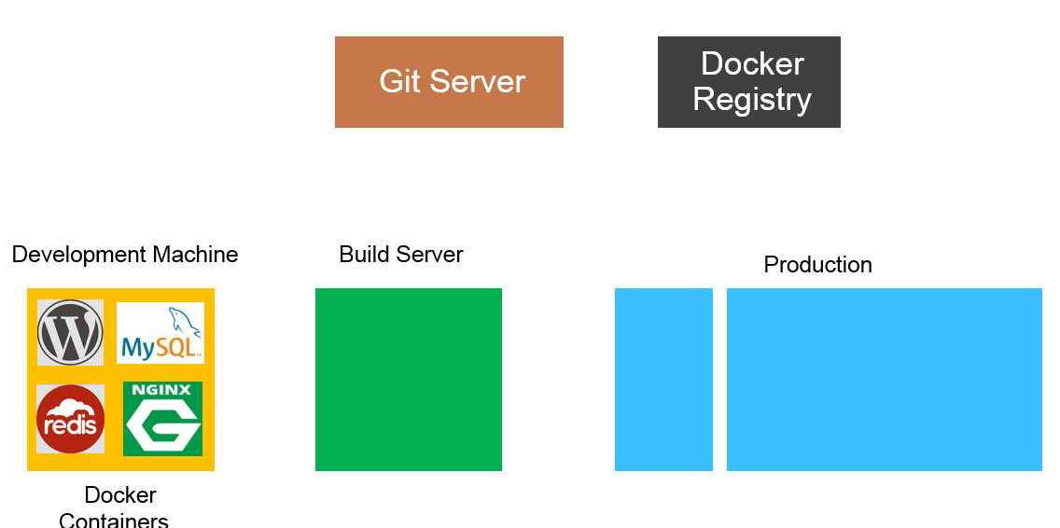


Slide 6
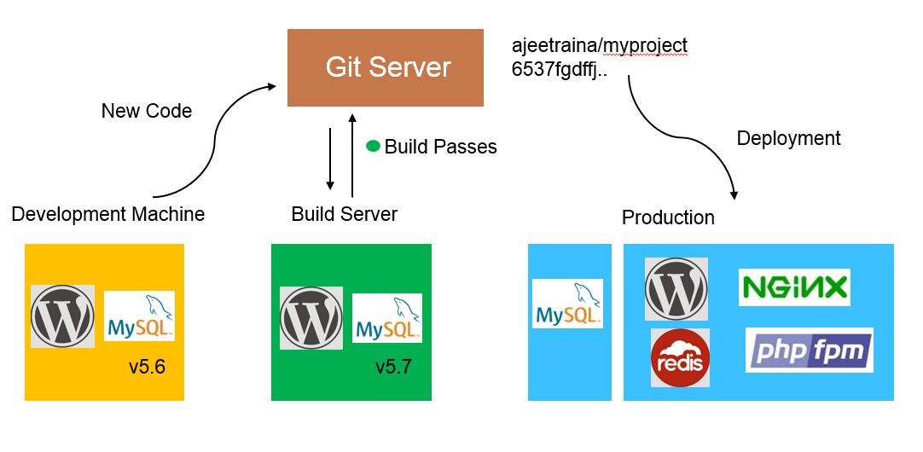

Slide 7
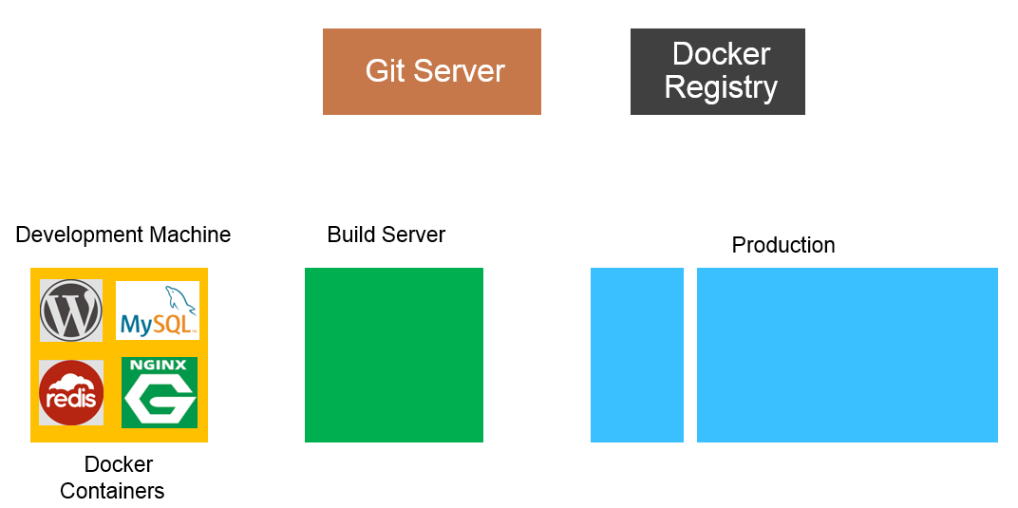

Slide 8
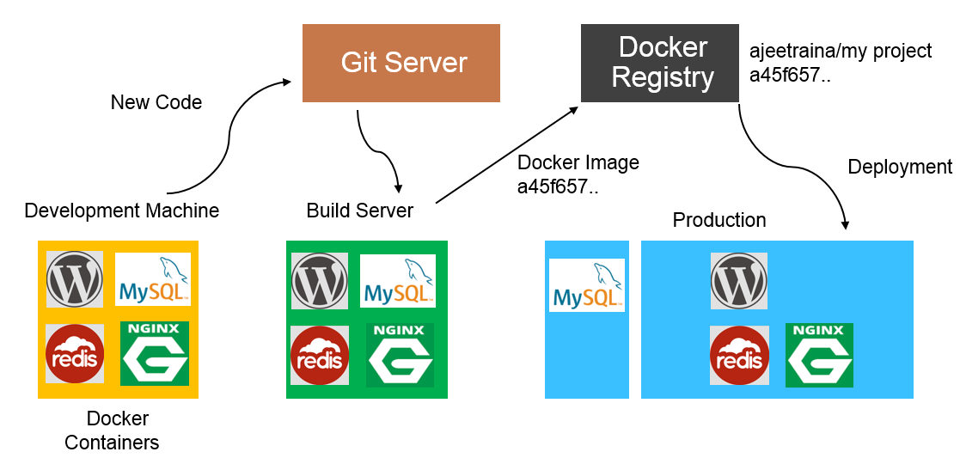

Slide 9
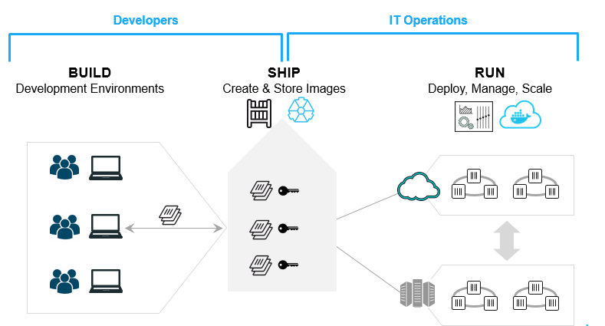
Build. Ship. Run.

Slide 10
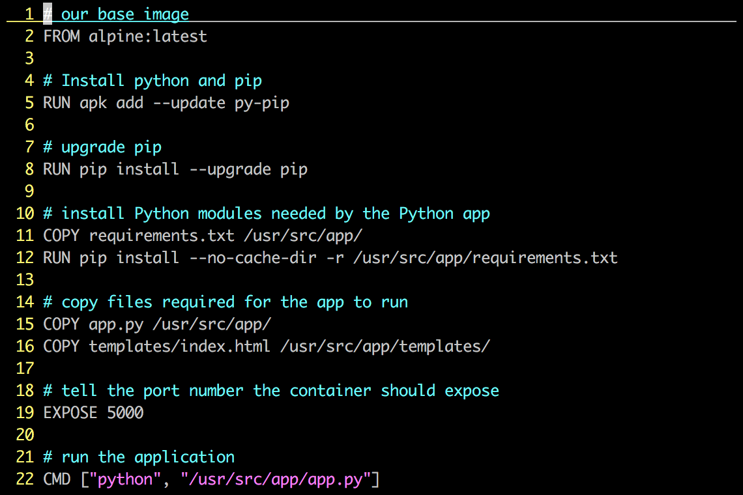
Dockerfile – Example

Slide 11
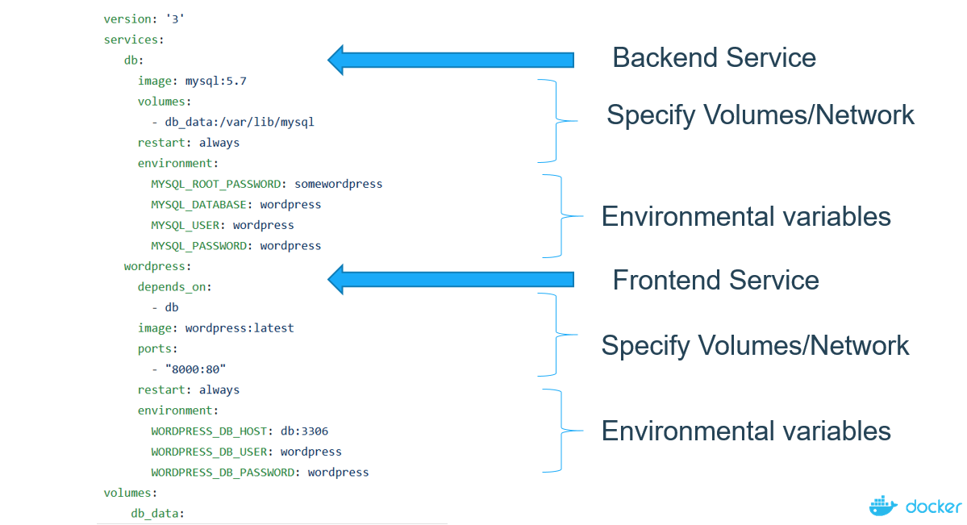
Docker Compose
Compose is a tool for defining and running multi-container Docker applications
Notes:
Compose is a tool for defining and running multi-container Docker applications

Slide 12
Let’s Go!

